Slide 1
GMR Institute of Technology

Slide 2
A REVIEW ON
CORE JAVA

Slide 3
TABLE OF CONTENTS
What is Java ?
Where is Java used ?
Features of Java
Java Program Translation
Java Virtual Machine
Java system overview
Java Program-Development phase
Advantage of java
Disadvantage of java

Slide 4
WHAT IS JAVA
Java is Object Oriented Programming language as well as Platform.
Java was developed by a team led by James Gosling at Sun Microsystems.
Java is a first programming language which provide the concept of writing programs that can be executed using the web.

Slide 5
FEATURES OF JAVA
Java is Simple.
Java is Object Oriented
Java is Distributed
Java is Architecture Neutral
Java is Robust
Java is Interpreted and Compiled
Java is Secure
Java is Portable
Java is Multi-Threaded

Slide 6
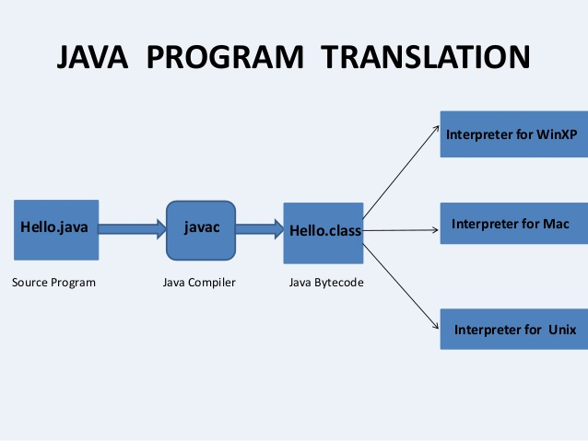
JAVA PROGRAM TRANSLATION

Slide 7
WHAT IS OOP ?
Object-oriented programming is a method of implementation.
A language in which everything represent in the
form of Object is called Object Oriented Programming Language.
It not only makes the program less complex but
also makes the software reuse feasible and possible.
Java is not truly Object Oriented Programing Language

Slide 8
CONCEPTS OF OOP
Object
Class
Encapsulation
Inheritance
Polymorphism
Abstraction

Slide 9
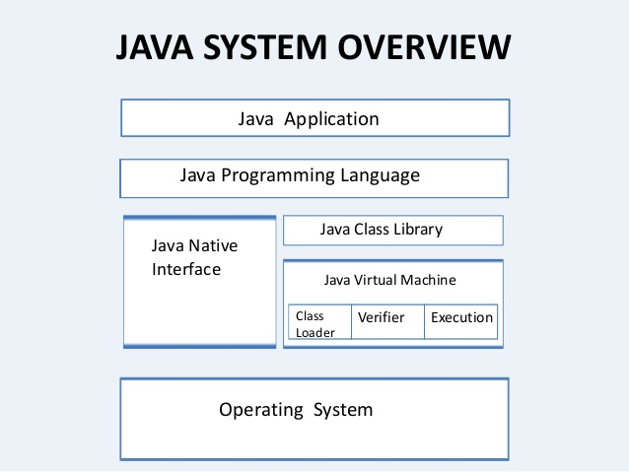

Slide 10
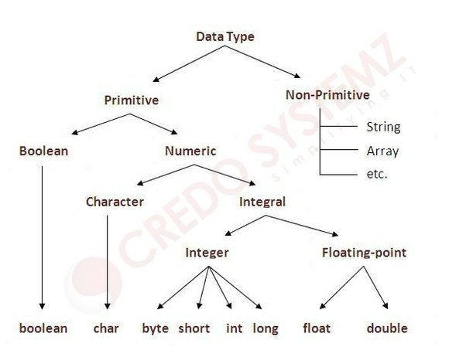
DATA TYPES

Slide 11
GARBAGE COLLECTION
Garbage collection is the mechanism that De allocate
the memory of an object when it is no longer referenced by a variable.
In C++, the memory of an Object is released by use of delete operator.
Java virtual machine determines when to free up the memory of an object.

Slide 12
THANK YOU

